Slide 1
SonarQube-Rule-Customization
July 17, 2020
1

Slide 2
Overview of SonarQube
SonarQube (formerly Sonar) is an open-source platform developed by SonarSource for continuous inspection of code quality to perform automatic reviews with static analysis of code to detect bugs, code smells, and security vulnerabilities on 20+ programming languages.
Each category has a corresponding number of issues or a percentage value.
Issues can have one of five different severity levels: blocker, critical, major, minor and info.
SonarQube offers reports on duplicated code, coding standards, unit tests, code coverage, code complexity, comments, bugs, and security vulnerabilities.
SonarQube provides fully automated analysis and integration with Maven, Ant, Gradle, MSBuild and continuous integration tools (Atlassian Bamboo, Jenkins, Hudson, etc.).
SonarQube integrates with Eclipse, Visual Studio, and IntelliJ IDEA development environments through the SonarLint plug-ins, and also integrates with external tools like LDAP, Active Directory, GitHub, and others.
SonarQube is expandable with the use of plug-ins.

Slide 3
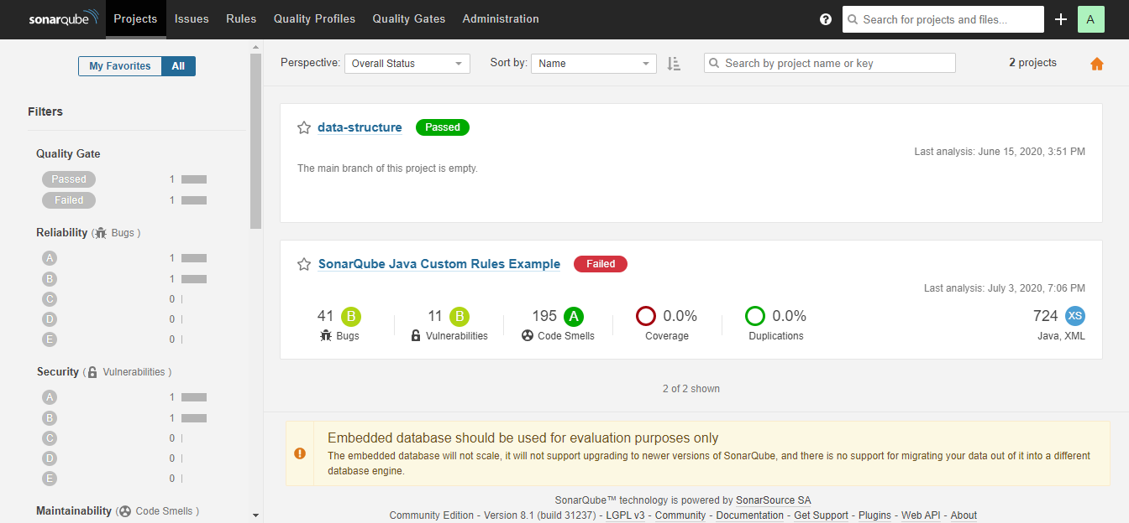
SonarQube Report

Slide 4
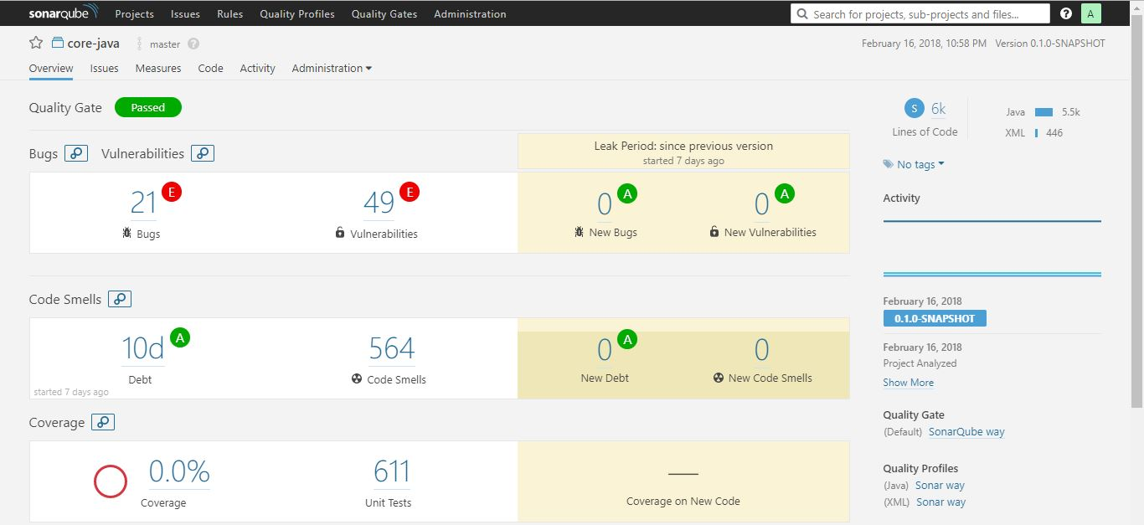
SonarQube Report

Slide 5
SonarQube Internal Architecture

Slide 6
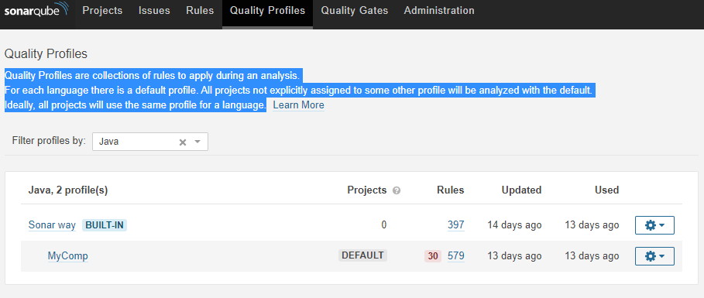
Quality Profiles
Quality Profiles are collections of rules to apply during an analysis.

Slide 7
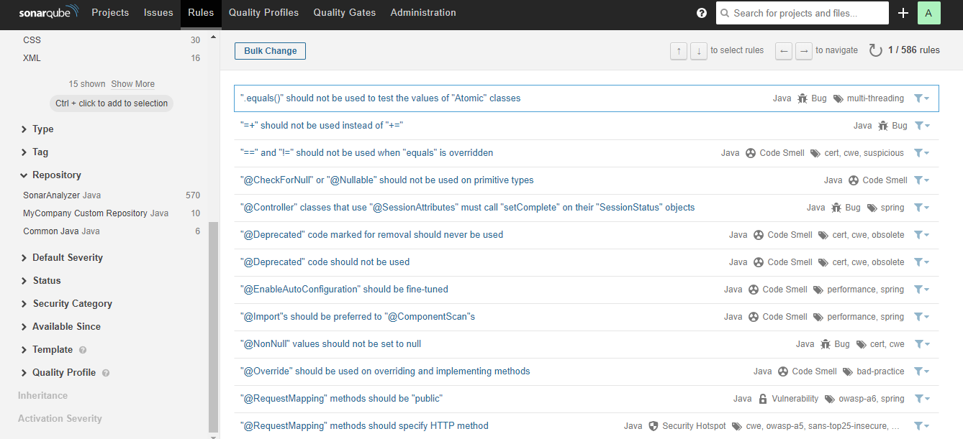
SonarQube Rules

Slide 8
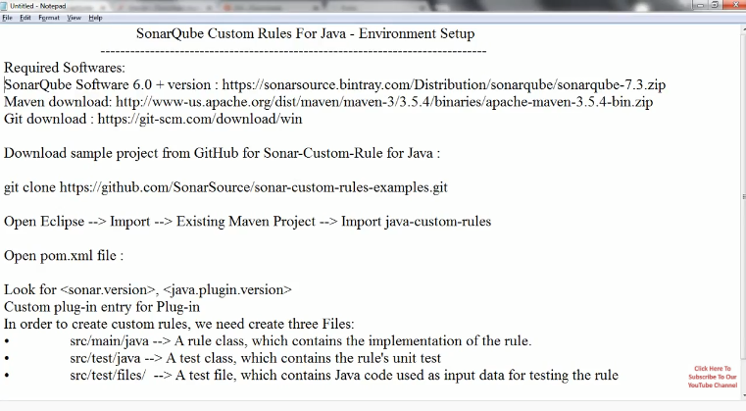
Writing Custom Rules For Java in SonarQube

Slide 9
To create our first custom rule
1.In folder /src/test/files, create a new empty file named MyFirstCustomCheck.java, and copy-paste the content of the following code snippet.
MyFirstCustomCheck.java
1
2
3
class MyClass {
}

Slide 10
To create our first custom rule
2.In package org.sonar.samples.java.checks of /src/test/java, create a new test class called MyFirstCustomCheckTest and copy-paste the content of the following code snippet.
MyFirstCustomCheckTest.java
package org.sonar.samples.java.checks;
import org.junit.Test;
public class MyFirstCustomCheckTest {
@Test
public void test() {
JavaCheckVerifier.verify("src/test/files/MyFirstCustomCheck.java", new MyFirstCustomCheck());
}
}

Slide 11
To create our first custom rule
3.In package org.sonar.samples.java.checks of /src/main/java, create a new class called MyFirstCustomCheck extending class org.sonar.plugins.java.api.IssuableSubscriptionVisitor provided by the Java Plugin API. Then, replace the content of the nodesToVisit() method with the content from the following code snippet (you may have to import com.google.common.collect.ImmutableList). This file will be described when dealing with implementation of the rule!
MyFirstCustomCheck.java
package org.sonar.samples.java.checks;
import com.google.common.collect.ImmutableList;
import org.sonar.plugins.java.api.IssuableSubscriptionVisitor;
import org.sonar.plugins.java.api.tree.Tree.Kind;
import java.util.List;
@Rule(key = "MyFirstCustomRule")
public class MyFirstCustomCheck extends IssuableSubscriptionVisitor {
@Override
public List<Kind> nodesToVisit() {
return ImmutableList.of();
}
}

Slide 12
Build & Deployment
After creating all the relevant files for SonarQube rule customization, build the library using maven or any other build tool.
Copy the jar file from target directory to $HOME\sonarqube-8.1.0.31237\extensions\plugins directory
Start the sonar server by clicking StartSonar under $HOME\sonarqube-8.1.0.31237\bin\windows-x86-64\ directory.
Verify the rule is present in the repository section in sonarqube admin screen.

Slide 13
Custom - TO Naming Convention Rule
package com.sonar.test;
public class TONameVerify {
boolean booleanVarTO;
byte byteVar;
short shortVar;
long longVar;
//Employee empTO;
}

Slide 14
Custom - Business Service Naming Convention Rule
package com.sonar.test;
import com.sonar.service.BusinessService;
public class BcPartnerService extends BusinessService{
}

Slide 15
Custom – ImmutableMap Variable Type Rule
package com.sonar.test;
import java.util.Map;
import com.google.common.collect.ImmutableMap;
public class ImutableMapTest {
public void methodTest1() {
Map<String, String> immutableMap = ImmutableMap.of("United States", "Washington D.C.");
}
}

Slide 16
Custom – Singleton Pattern Thread Safety Rule
package com.sonar.test;
public final class Singleton {
private static volatile Singleton instance = null;
private Singleton() {
}
public static Singleton getInstance2() {
if (instance == null) {
//synchronized (Singleton.class) {
if (instance == null) {
instance = new Singleton();
}
//}
}
return instance;
}
}

Slide 17
Custom – CircuitBreaker Fallback Method Rule
package com.sonar.test;
import java.util.Date;
import org.springframework.beans.factory.annotation.Autowired;
import org.springframework.stereotype.Service;
import com.netflix.hystrix.contrib.javanica.annotation.HystrixCommand;
@Service
public class StudentServiceDelegate {
@Autowired
@HystrixCommand(fallbackMethod="callStudentServiceAndGetData_Fallback")
public String callStudentServiceAndGetData(String schoolname) {
System.out.println("Getting School details ");
return "NORMAL FLOW !!! - School Name - " + schoolname + " ::: Student Detail";
}
@SuppressWarnings("unused")
private String callStudentServiceAndGetData_FallbackNew(String schoolname) {
System.out.println("Student Service is down!!! fallback route enabled...");
return "CIRCUIT BREAKER ENABLED!!!No Response From Student Service at this moment. Service will be back shortly - " + new Date();
}
}

Slide 18
Demo on SonarQube Rule Customization.
Demo on SonarQube Rule Customization.

